Slide 1
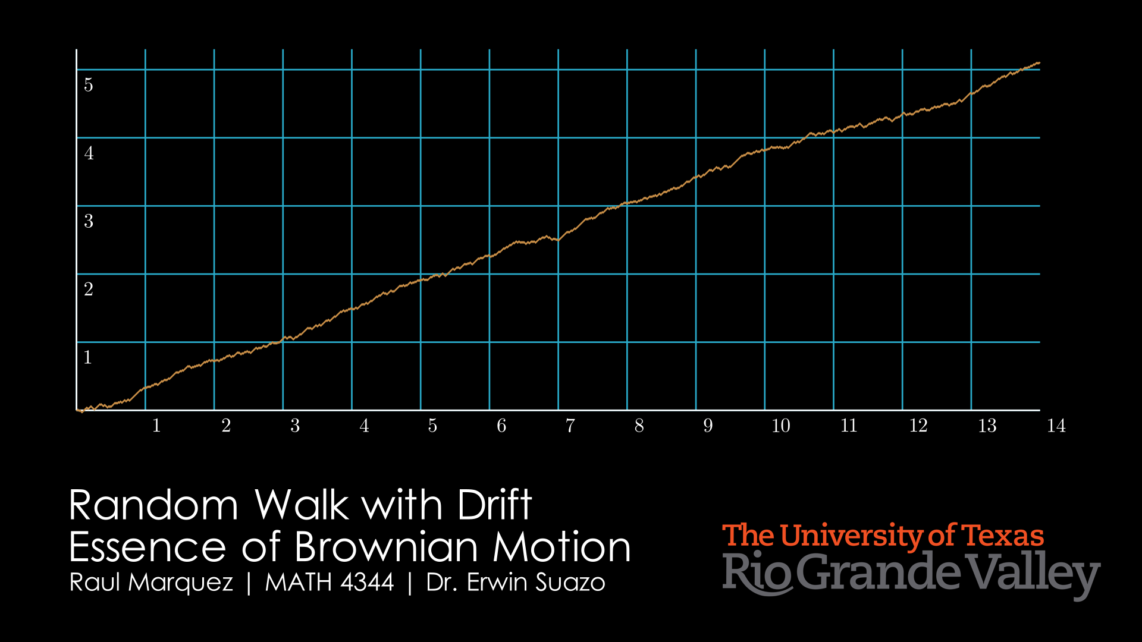

Slide 2
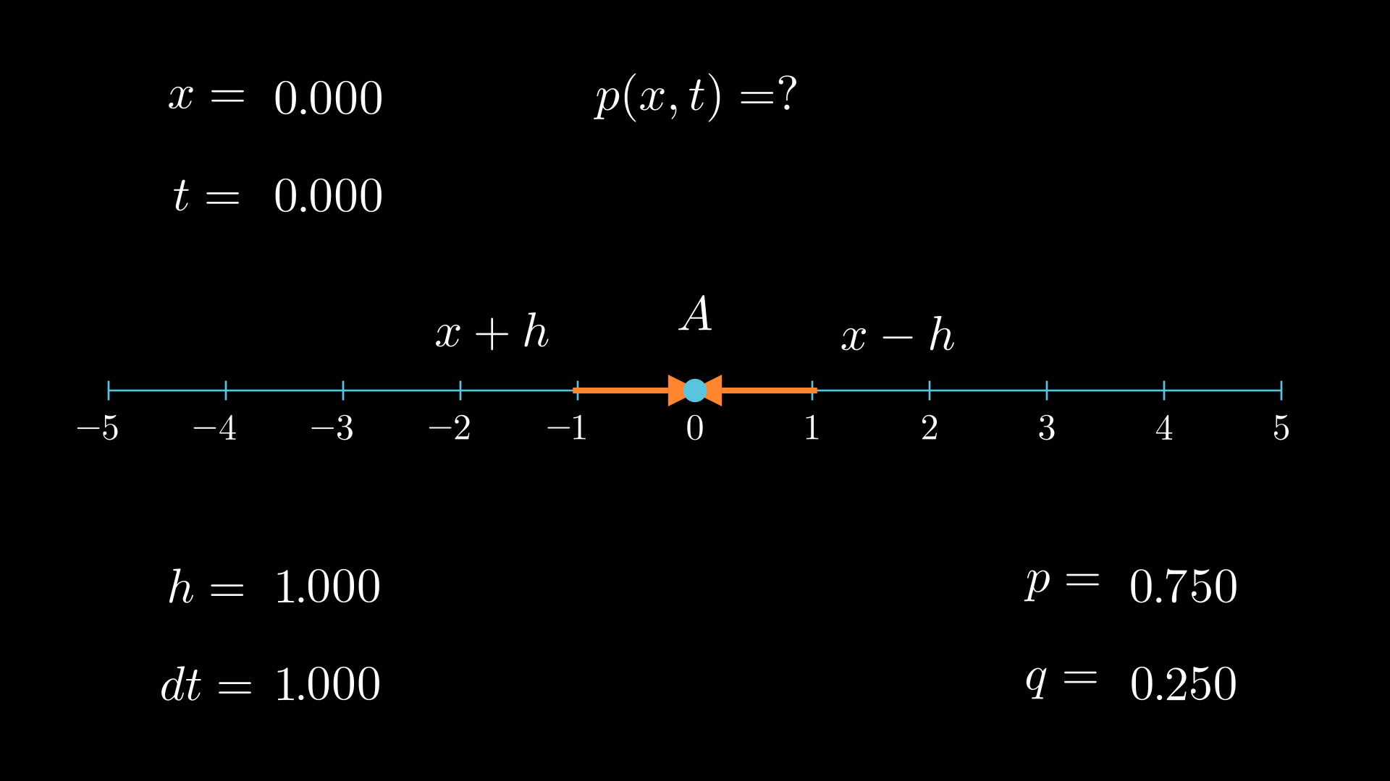
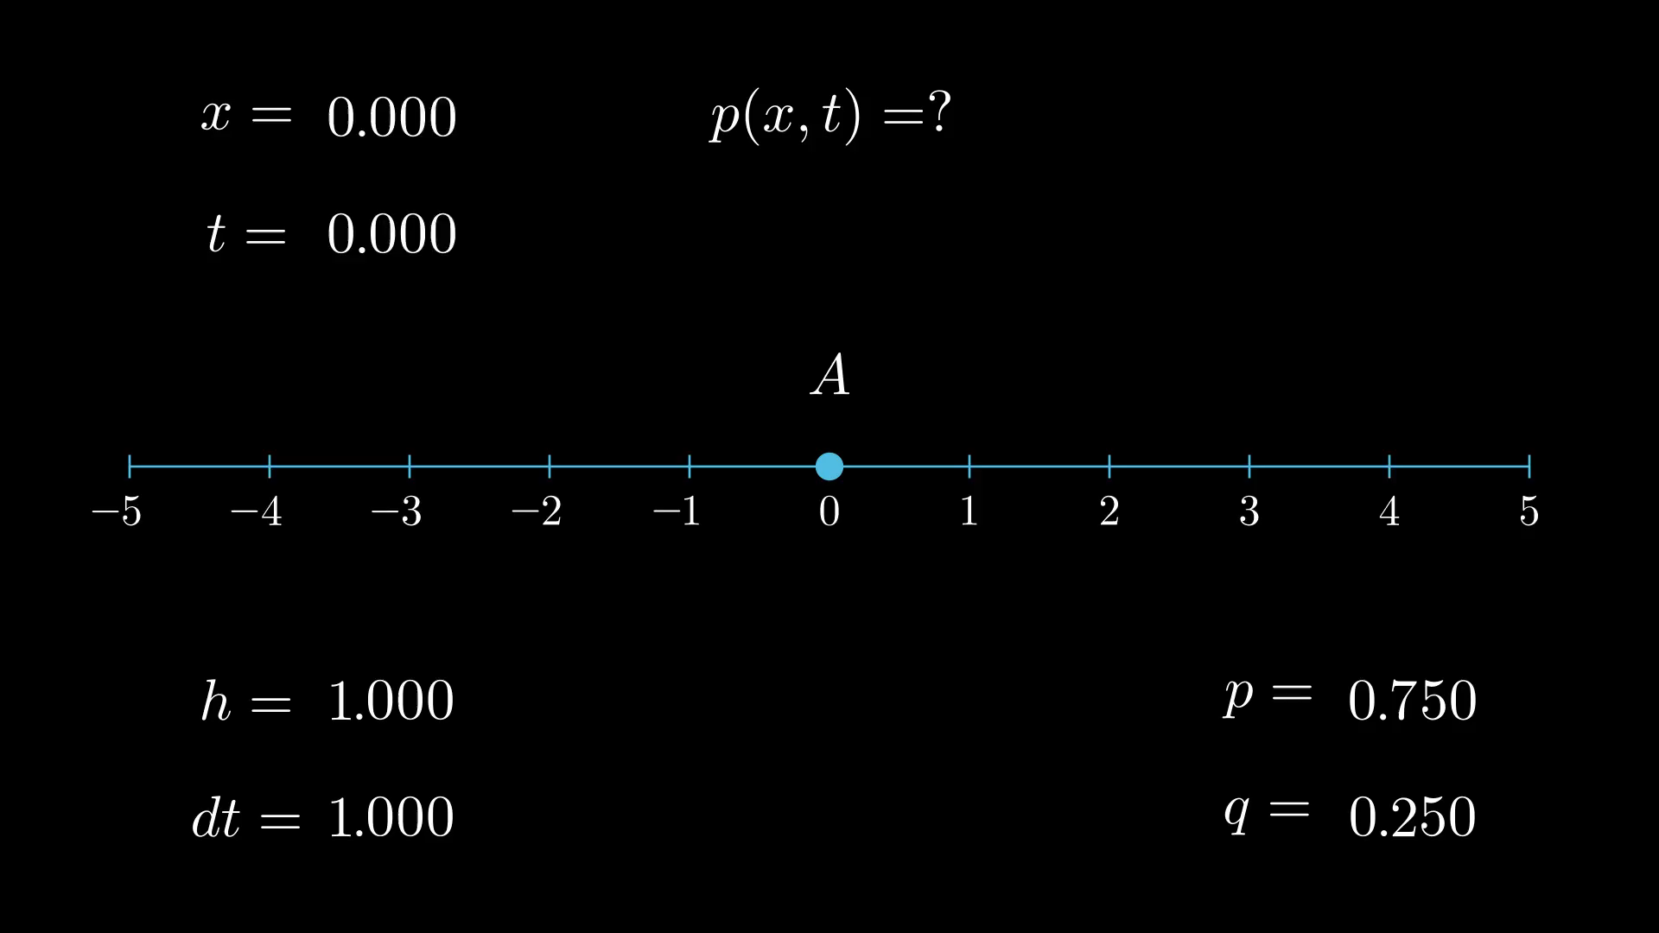

Slide 3
Preliminary Computations
x = mh, where m is the number of steps away from the origin
T = Nt, where N is the number of steps
Let k be the number of steps to the right, and N – k be the number of steps to the left
Then, m = k – (N – k) = k + k – N = 2k – N
Thus, k = (N + m)/2
Probability = Outcomes in A / Outcomes in Sample Space, and pk = p(x,t), so
p(x,t) = Number of walks with k steps to right after N Events / Number of Possible Walks with N steps
Number of Possible walks of k with N steps = C(n,k) = N! / k!(n-k)!
Number of Possible walks with N steps = 2^N
We need to put in terms of h and t, so we may get the limit as h and t -> 0

Slide 4
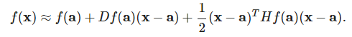
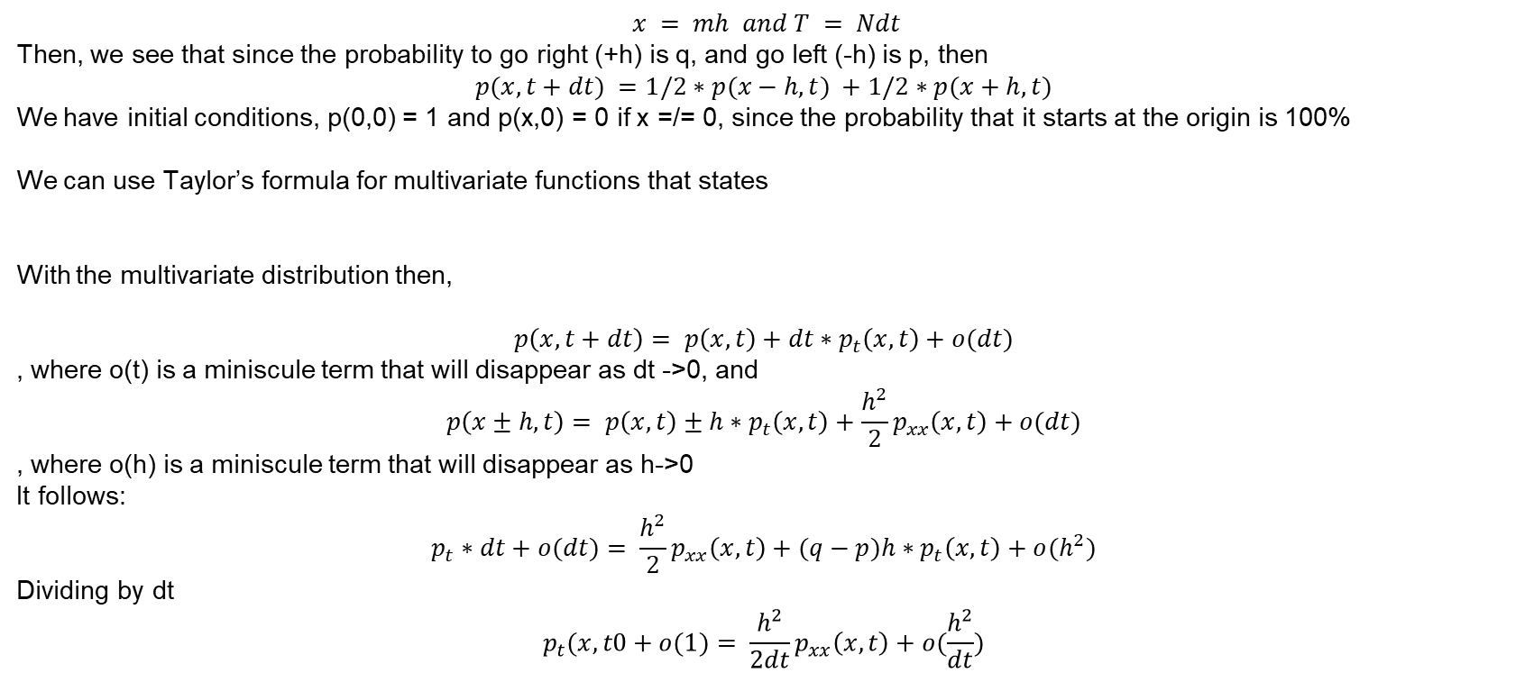
Formula for p(x,t) | Limit Transition Probability
$$x = mh and T = Ndt$$
Then, we see that since the probability to go right (+h) is q, and go left (-h) is p, then
$$p(x,t+dt) =1/2∗p(x−h,t) +1/2∗p(x+h,t)$$
We have initial conditions, p(0,0) = 1 and p(x,0) = 0 if x =/= 0, since the probability that it starts at the origin is 100%
We can use Taylor’s formula for multivariate functions that states
With the multivariate distribution then,
$$p\left(x,t+dt\right)= p\left(x,t\right)+dt∗p_{t}\left(x,t\right)+o(dt)$$
, where o(t) is a miniscule term that will disappear as dt ->0, and
$$p\left(x±h,t\right)= p\left(x,t\right)±h∗p_{t}\left(x,t\right)+\frac{h^{2}}{2}p_{xx}\left(x,t\right)+o(dt)$$
, where o(h) is a miniscule term that will disappear as h->0
It follows:
$$p_{t}∗dt+o(dt)= \frac{h^{2}}{2}p_{xx}\left(x,t\right)+(q−p)h∗p_{t}\left(x,t\right)+o(h^{2})$$
Dividing by dt
$$p_{t}(x,t0+o(1)= \frac{h^{2}}{2dt}p_{xx}\left(x,t\right)+o(\frac{h^{2}}{dt})$$

Slide 5
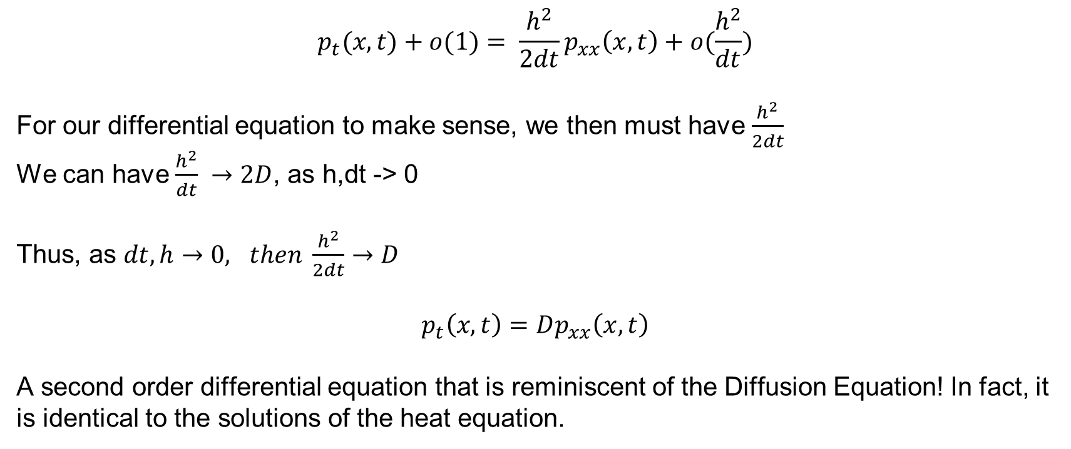
Formula for p(x,t) | Limit Transition Probability
$$p_{t}(x,t)+o(1)= \frac{h^{2}}{2dt}p_{xx}\left(x,t\right)+o(\frac{h^{2}}{dt})$$
For our differential equation to make sense, we then must have $\frac{h^{2}}{2dt}$
We can have $\frac{h^{2}}{dt} →2D$, as h,dt -> 0
Thus, as $dt, h→0, then \frac{h^{2}}{2dt}→D$
$$p_{t}\left(x,t\right)=Dp_{xx}\left(x,t\right)$$
A second order differential equation that is reminiscent of the Diffusion Equation! In fact, it is identical to the solutions of the heat equation.

Slide 6
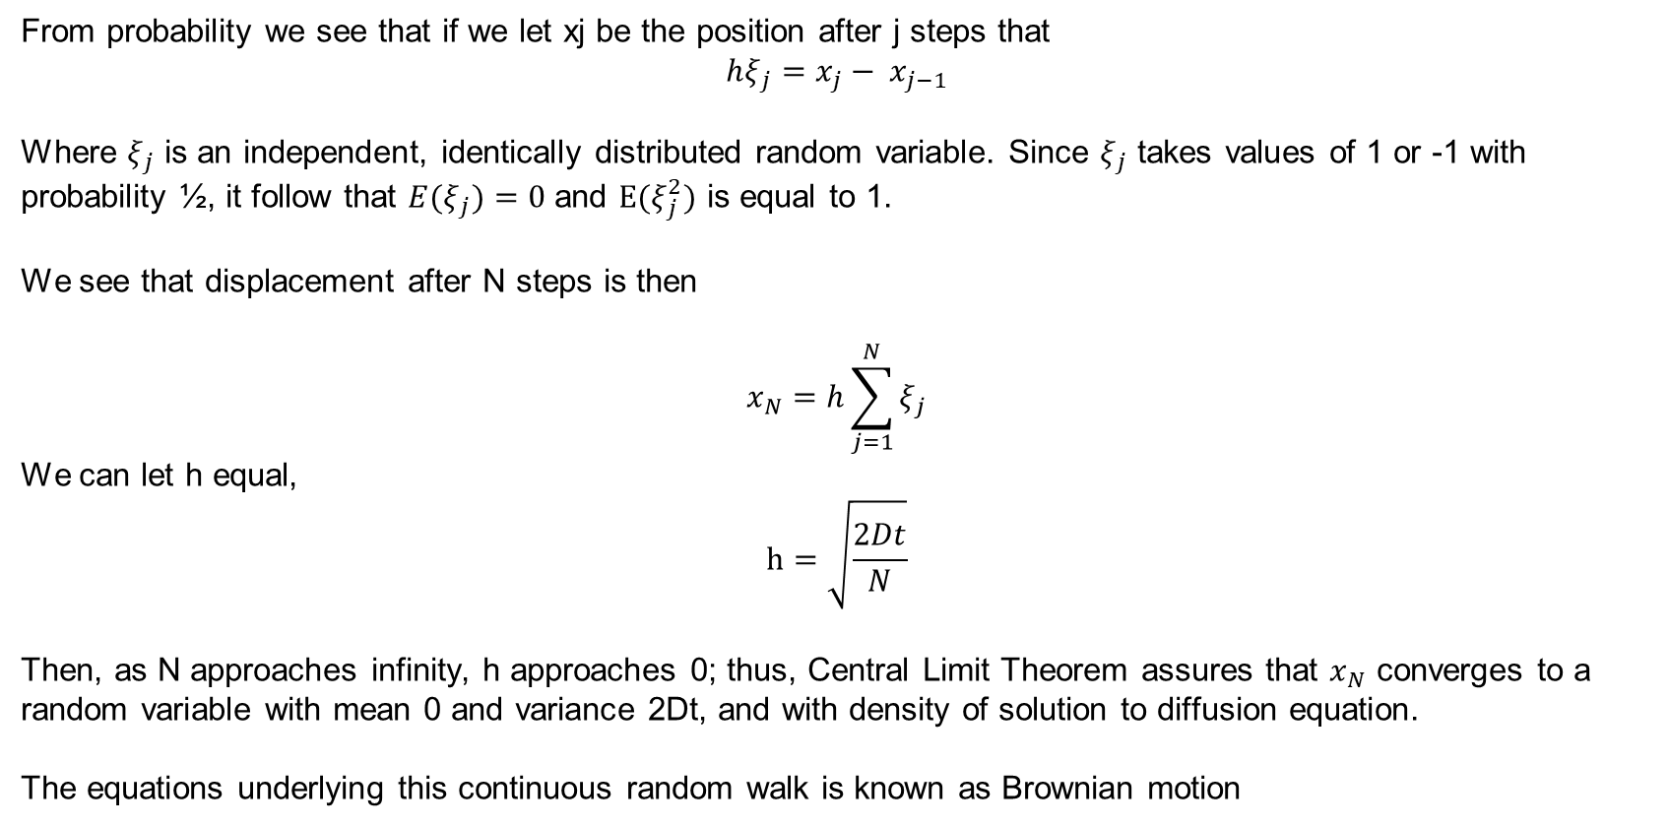
Continuity of p(x,t) and Brownian Motion
From probability we see that if we let xj be the position after j steps that
$$hξ_{j}=x_{j}− x_{j−1}$$
Where $ξ_{j}$ is an independent, identically distributed random variable. Since $ξ_{j}$ takes values of 1 or -1 with probability ½, it follow that ${E(ξ}_{j})=0$ and $E(ξ_{j}^{2})$ is equal to 1.
We see that displacement after N steps is then
$$x_{N}=h\sum_{j=1}^{N}{ξ_{j}}$$
We can let h equal, $$h=\sqrt{\frac{2Dt}{N}}$$
Then, as N approaches infinity, h approaches 0; thus, Central Limit Theorem assures that $x_{N}$ converges to a random variable with mean 0 and variance 2Dt, and with density of solution to diffusion equation.
The equations underlying this continuous random walk is known as Brownian motion

Slide 7
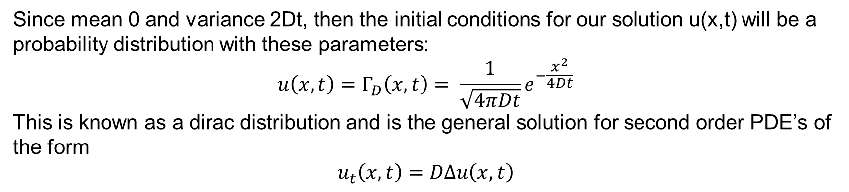
Dirac Distribution
Since mean 0 and variance 2Dt, then the initial conditions for our solution u(x,t) will be a probability distribution with these parameters:
$$u\left(x,t\right)=Γ_{D}\left(x,t\right)= \frac{1}{\sqrt{4πDt}}e^{−\frac{x^{2}}{4Dt}}$$
This is known as a dirac distribution and is the general solution for second order PDE’s of the form
$$u_{t}\left(x,t\right)=DΔu\left(x,t\right)$$

Slide 8
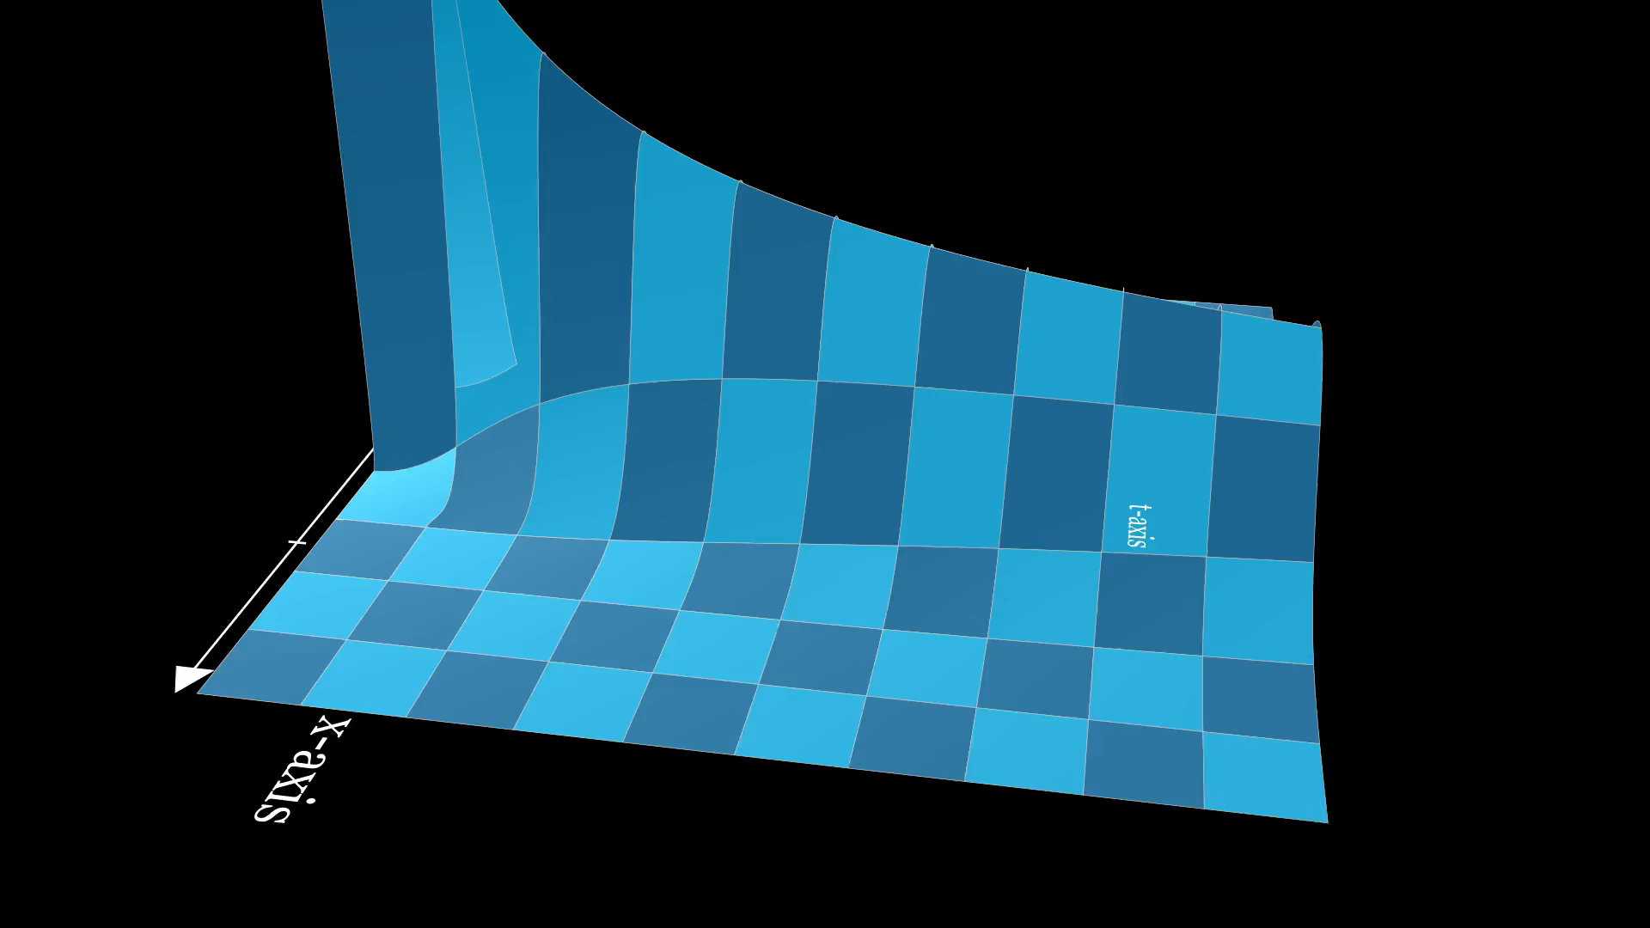

Slide 9
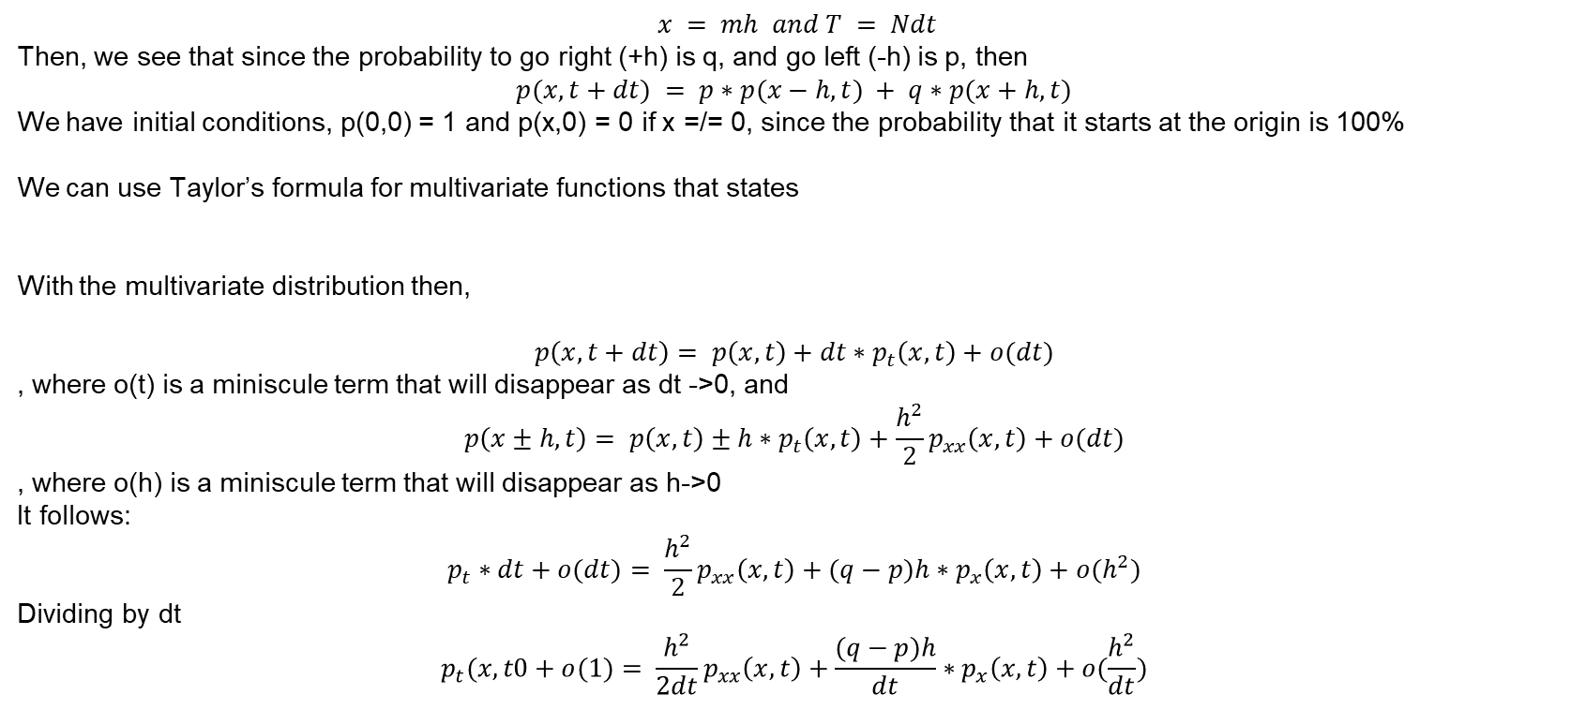
Formula for p(x,t) | Limit Transition Probability
$$x = mh and T = Ndt$$
Then, we see that since the probability to go right (+h) is q, and go left (-h) is p, then
$$p(x,t+dt) = p∗p(x−h,t) + q∗p(x+h,t)$$
We have initial conditions, p(0,0) = 1 and p(x,0) = 0 if x =/= 0, since the probability that it starts at the origin is 100%
We can use Taylor’s formula for multivariate functions that states
With the multivariate distribution then,
$$p\left(x,t+dt\right)= p\left(x,t\right)+dt∗p_{t}\left(x,t\right)+o(dt)$$
, where o(t) is a miniscule term that will disappear as dt ->0, and
$$p\left(x±h,t\right)= p\left(x,t\right)±h∗p_{t}\left(x,t\right)+\frac{h^{2}}{2}p_{xx}\left(x,t\right)+o(dt)$$
, where o(h) is a miniscule term that will disappear as h->0
It follows:
$$p_{t}∗dt+o(dt)= \frac{h^{2}}{2}p_{xx}\left(x,t\right)+(q−p)h∗p_{x}\left(x,t\right)+o(h^{2})$$
Dividing by dt
$$p_{t}(x,t0+o(1)= \frac{h^{2}}{2dt}p_{xx}\left(x,t\right)+\frac{(q−p)h}{dt}∗p_{x}\left(x,t\right)+o(\frac{h^{2}}{dt})$$

Slide 10
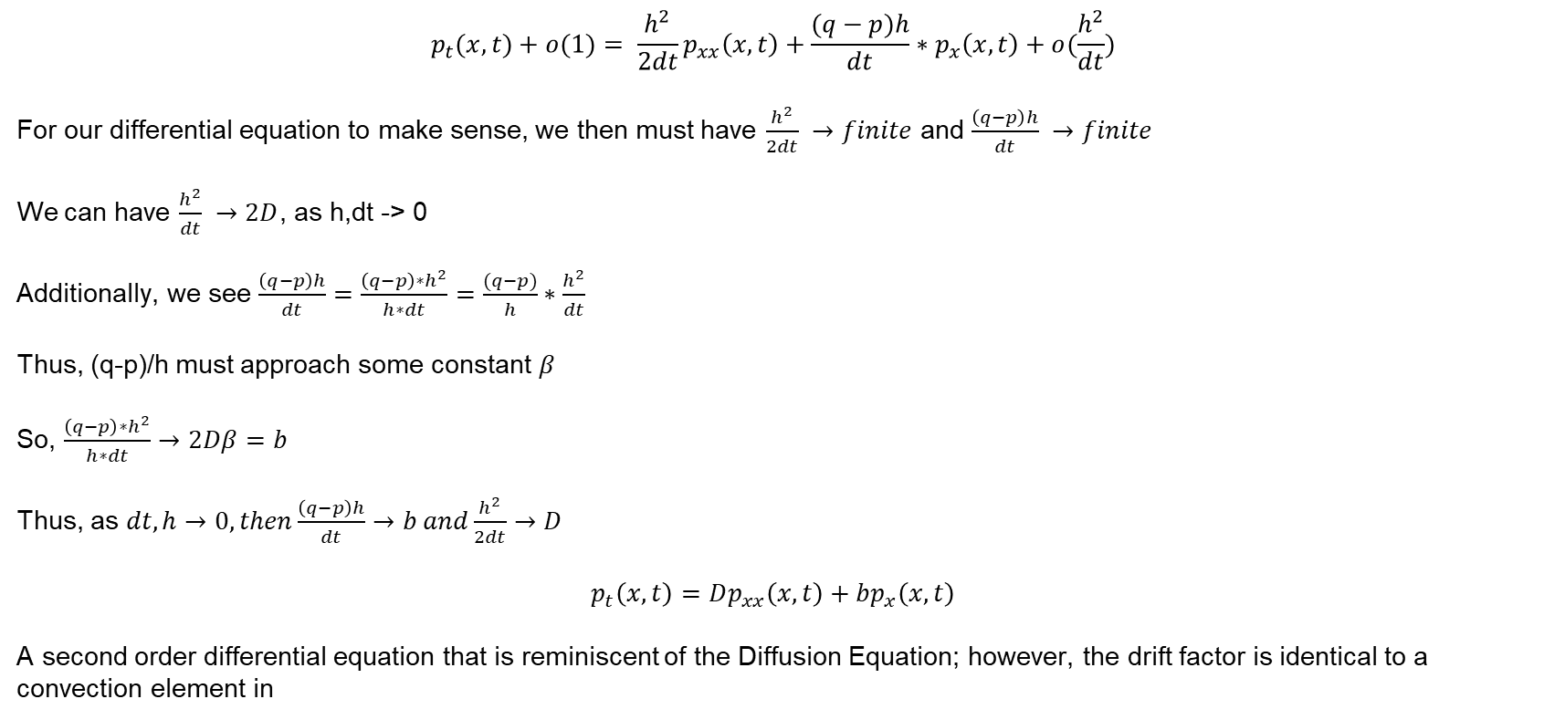
Formula for p(x,t) | Limit Transition Probability
$$p_{t}(x,t)+o(1)= \frac{h^{2}}{2dt}p_{xx}\left(x,t\right)+\frac{(q−p)h}{dt}∗p_{x}\left(x,t\right)+o(\frac{h^{2}}{dt})$$
For our differential equation to make sense, we then must have $\frac{h^{2}}{2dt} →finite$ and $\frac{\left(q−p\right)h}{dt} →finite$
We can have $\frac{h^{2}}{dt} →2D$, as h,dt -> 0
Additionally, we see $\frac{\left(q−p\right)h}{dt}=\frac{{\left(q−p\right)∗h}^{2}}{h∗dt}=\frac{(q−p)}{h}∗\frac{h^{2}}{dt}$
Thus, (q-p)/h must approach some constant $β$
So, $\frac{{\left(q−p\right)∗h}^{2}}{h∗dt}→2Dβ=b$
Thus, as $dt, h→0, then\frac{\left(q−p\right)h}{dt}→b and\frac{h^{2}}{2dt}→D$
$$p_{t}\left(x,t\right)=Dp_{xx}\left(x,t\right)+bp_{x}\left(x,t\right)$$
A second order differential equation that is reminiscent of the Diffusion Equation; however, the drift factor is identical to a convection element in

Slide 11
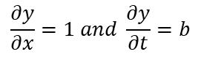
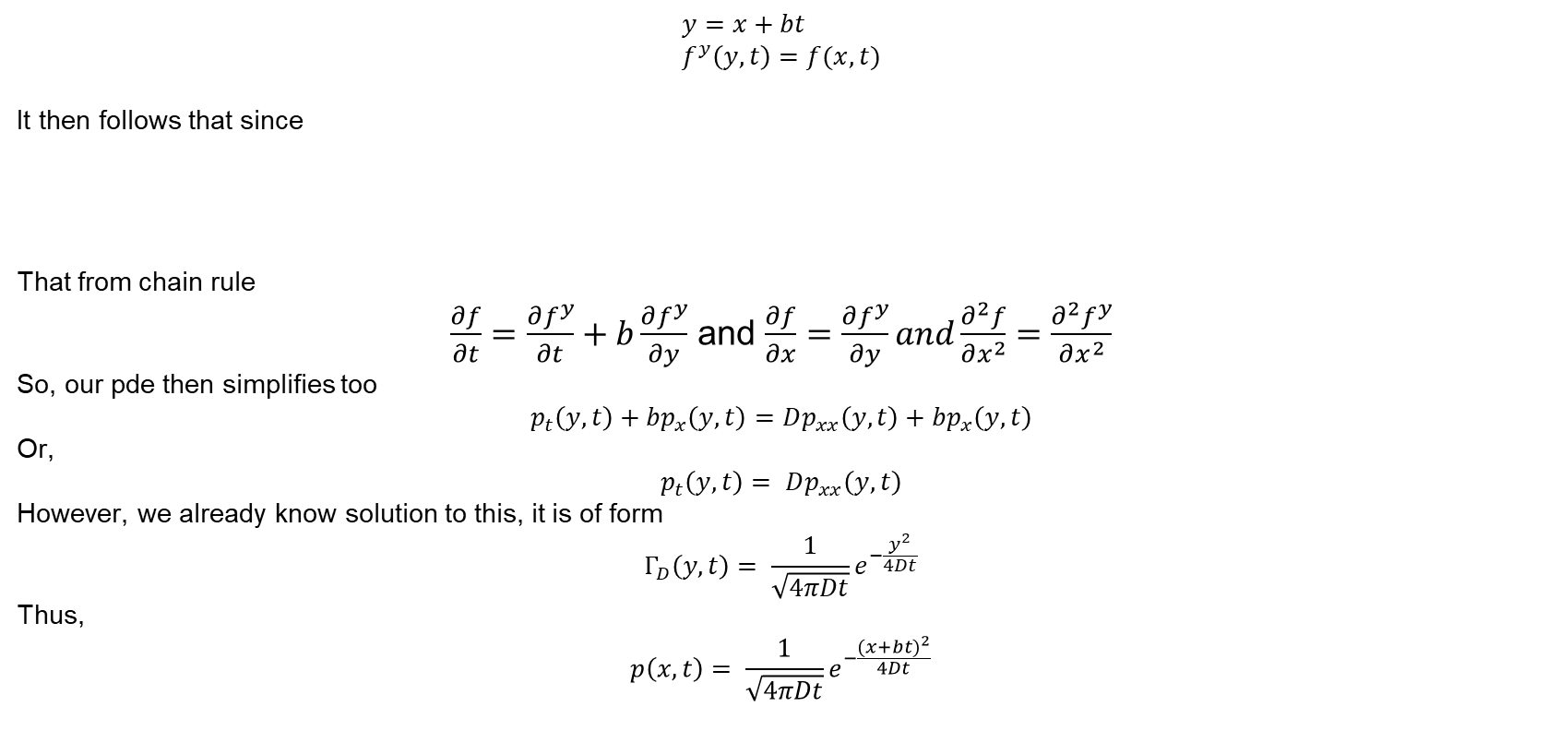
Solution with Change of Variables
$$y=x+bt \\ f^{y}\left(y,t\right)=f(x,t)$$
It then follows that since
That from chain rule
$\frac{∂f}{∂t}=\frac{∂f^{y}}{∂t}+b\frac{∂f^{y}}{∂y}$ and $\frac{∂f}{∂x}=\frac{∂f^{y}}{∂y}and\frac{∂^{2}f}{∂x^{2}}=\frac{∂^{2}f^{y}}{∂x^{2}}$
So, our pde then simplifies too
$$p_{t}\left(y,t\right)+bp_{x}\left(y,t\right)=Dp_{xx}\left(y,t\right)+bp_{x}\left(y,t\right)$$
Or,
$$p_{t}\left(y,t\right)= Dp_{xx}\left(y,t\right)$$
However, we already know solution to this, it is of form
$$Γ_{D}\left(y,t\right)= \frac{1}{\sqrt{4πDt}}e^{−\frac{y^{2}}{4Dt}}$$
Thus,
$$p\left(x,t\right)= \frac{1}{\sqrt{4πDt}}e^{−\frac{{(x+bt)}^{2}}{4Dt}}$$
$$\frac{∂y}{∂x}=1 and \frac{∂y}{∂t}=b$$

Slide 12
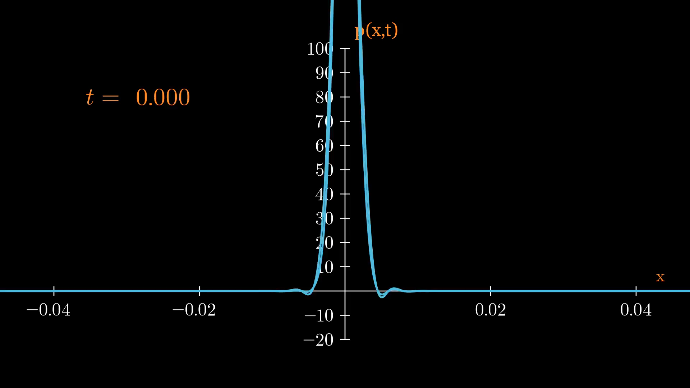

Slide 13
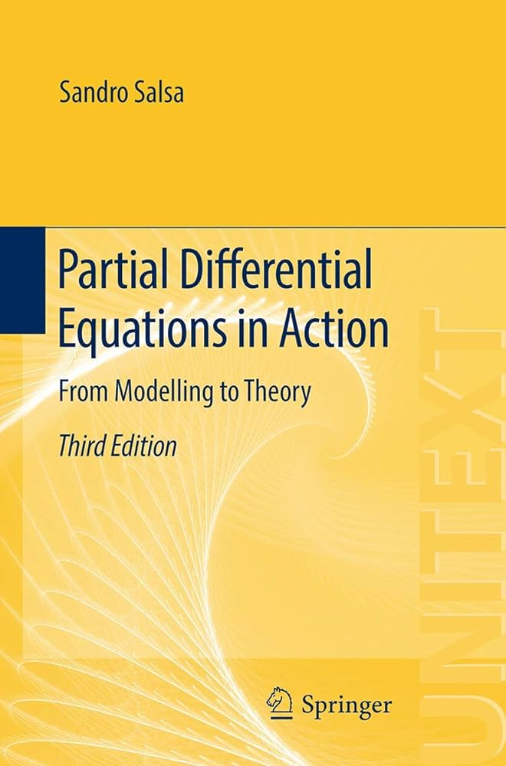
References
GIANMARIA, S. S. V. (2023). Partial differential equations in action: From modelling to theory. SPRINGER INTERNATIONAL PU.

